Slide 1
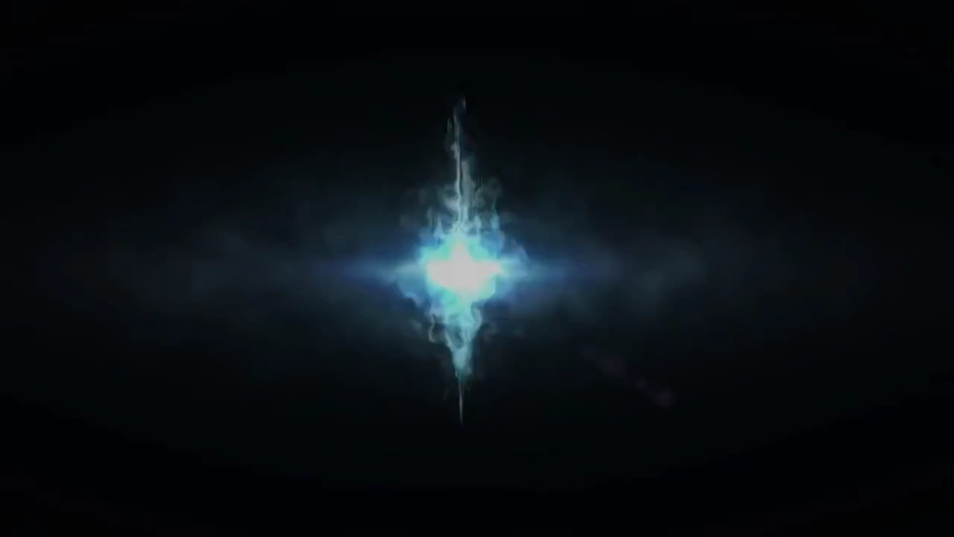

Slide 2
MTG Deck Color Advisor
Presented by Shweta Chandramouli and Abhinandan Patni

Slide 3
OUTLINE
Introduction
Related Work
Our Work
Impact of this project
Conclusion and Future work

Slide 4
INTRODUCTION
What is MTG?
Most popular trading card game
Started in 1993, has 20 million players today.
What are some of the problems players face?
What colors?
What strategy?
Where does Machine Learning come in?

Slide 5
PROBLEM STATEMENT
To create a system that suggests deck color(s) for players wishing to utilize certain mechanics of the MTG game for a new deck.

Slide 6
Related Work
The AI that learned Magic The Gathering.
AI bot that auto generated valid MTG cards using previous knowledge of officially distributed cards.
Magic The Gathering Deck Performance Prediction.
K-means clustering was used to classify decks.
Scores from 1 to 1000 were given to decks, depending on how well the decks would fare in professional tournaments.

Slide 7
OUR WORK
Gather data
Pre-process the data
Based on the correlation between rules and colors, do a preliminary exploration of data
Use classification techniques and compare the results
Design a small web portal to test classification

Slide 8
GATHERING DATA
Explored different datasets that we found
Chose one dataset with good JSON structure
Scraped the official database of MTG to match the JSON format
Appended scraped data to existing dataset

Slide 9
PREPROCESSED DATA
{
"name" : "Sen Triplets”,
"manaCost" : "{2}{W}{U}{B}”,
"cmc" : 5,
"colors" : ["White", "Blue", "Black"],
"supertypes" : ["Legendary"],
"types" : ["Artifact", "Creature"],
"subtypes" : ["Human", "Wizard"],
"rarity" : "Mythic Rare”,
"text" : "At the beginning of your upkeep, choose target opponent. This turn, that player can't cast spells or activate abilities and plays with his or her hand revealed. You may play cards from that player's hand this turn.”,
"power" : "3”,
"toughness" : "3”,
"multiverseid" : 180607
}

Slide 10
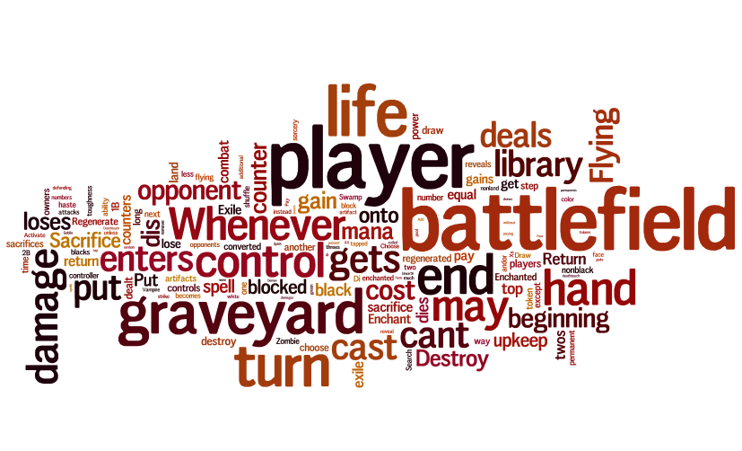
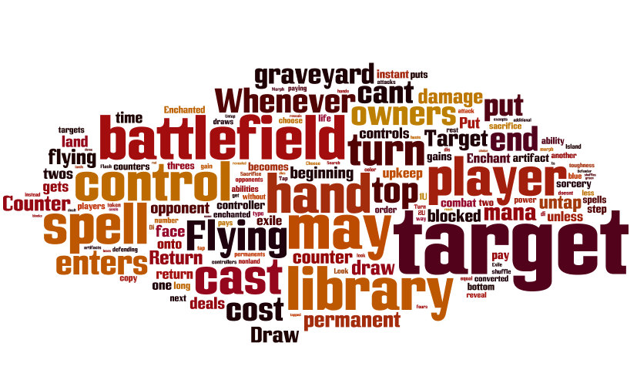
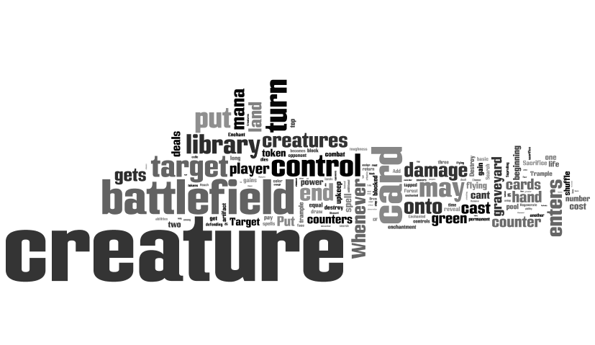
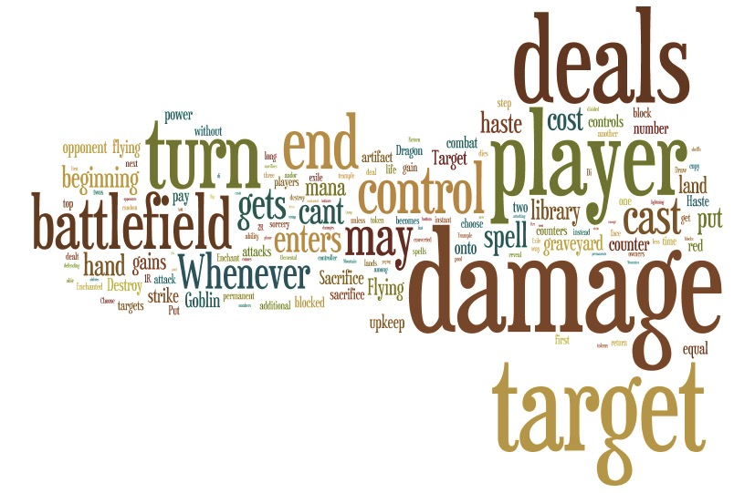
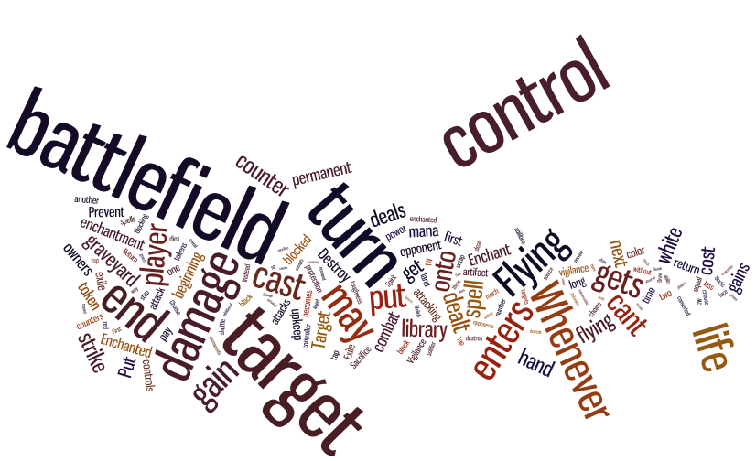
Preliminary Exploration of Data

Slide 11
CLASSIFICATION
After surveying some text classification techniques, we decided to use variations of 2 classification algorithms.
Naïve Bayes:
With / Without text injection, with / without TF-IDF
Support Vector Machines:
Linear
RBF
Polynomial
Sigmoid

Slide 12
NAÏVE BAYES
Initially implemented Naïve Bayes based on word counts
Improved accuracy by using TF-IDF as the main feature
Based on preliminary exploration of data, we decided to use word injection from a list of MTG keywords to give higher weightage to more relevant words
This worked well!

Slide 13
SUPPORT VECTOR MACHINES
Vectorized text based on TF-IDF based feature
Compared svm_multiclass and libsvm
Svm_multiclass performed best with RBF kernel
Got similar results
Compared algorithms based on the zero/one error and mean absolute error

Slide 14
RESULTS

Slide 15
FUTURE WORK
Recommendation system based on synergy of cards
Constraint satisfaction algorithm to find cards for a specific strategy
AI to play MTG with the above information

Slide 16
CONCLUSION
Developed a Flask-based frontend to display results for multinomial NB classification
Working on a weighted classification model which uses RBF-SVM model with multinomial NB and confidence scores to classify text
Demo!

Slide 17
THANK YOU!
QUESTIONS?

